Slide 1
Travel ai agent
IBM HACKATHON PROJECT
Presented By
Student name : Aadesh Singh
College Name & Department : Manipal University Jaipur (CSE)

Slide 2
OUTLINE
Problem Statement
Technology used
Wow factor
End users
Result
Conclusion
Git-hub Link
Future scope
IBM Certifications

Slide 3
Problem Statement
A Travel Planner Agent is an AI-powered assistant that helps users plan trips efficiently and intelligently. It uses real-time data to suggest destinations, build itineraries, and recommend transport and accommodation options. By understanding user preferences, budgets, and constraints, it tailors personalized travel plans. Integrated with maps, weather updates, and local guides, it ensures a smooth travel experience. The agent can also manage bookings, alert users to changes, and optimize schedules on the go. This smart assistant transforms complex travel planning into a seamless, enjoyable process.

Slide 4
Technology used
IBM cloud lite services
Natural Language Processing (NLP)
Retrieval Augmented Generation (RAG)
IBM Granite model

Slide 5
IBM cloud services used
IBM Cloud Watsonx AI Studio
IBM Cloud Watsonx AI runtime
IBM Cloud Agent Lab
IBM Granite foundation model

Slide 6
Wow factors
Conversational Destination Discovery
Adaptive Itinerary Intelligence
Real-Time Fare & Event Monitoring
One-Click Booking Assistant
Smart Packing Checklist

Slide 7
End users
Academic Researchers
Research Institutions and Universities
Industry R&D Teams
Educators

Slide 8
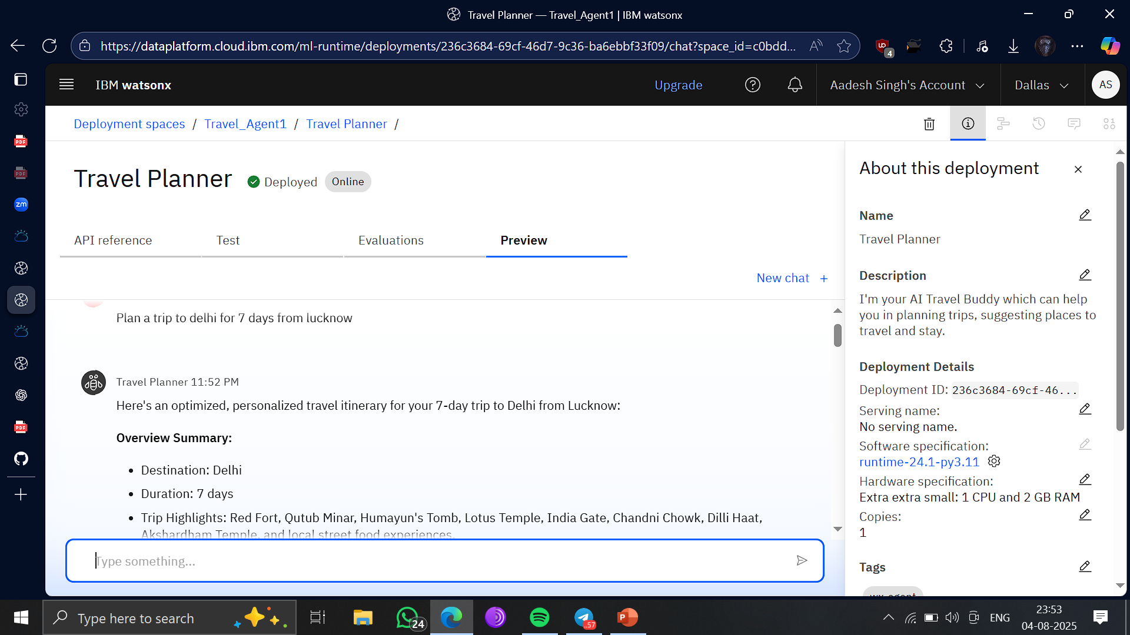
Results

Slide 9
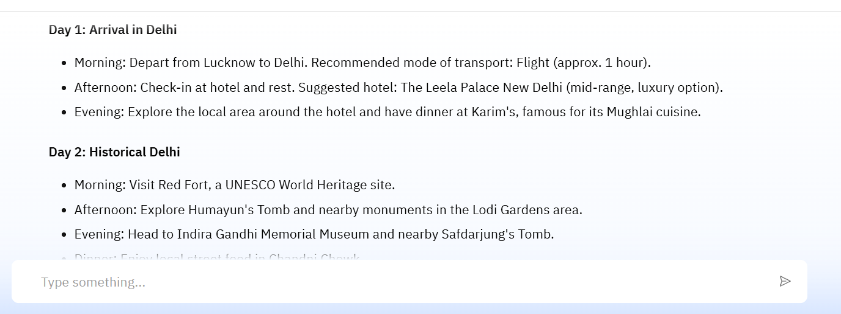
Results

Slide 10
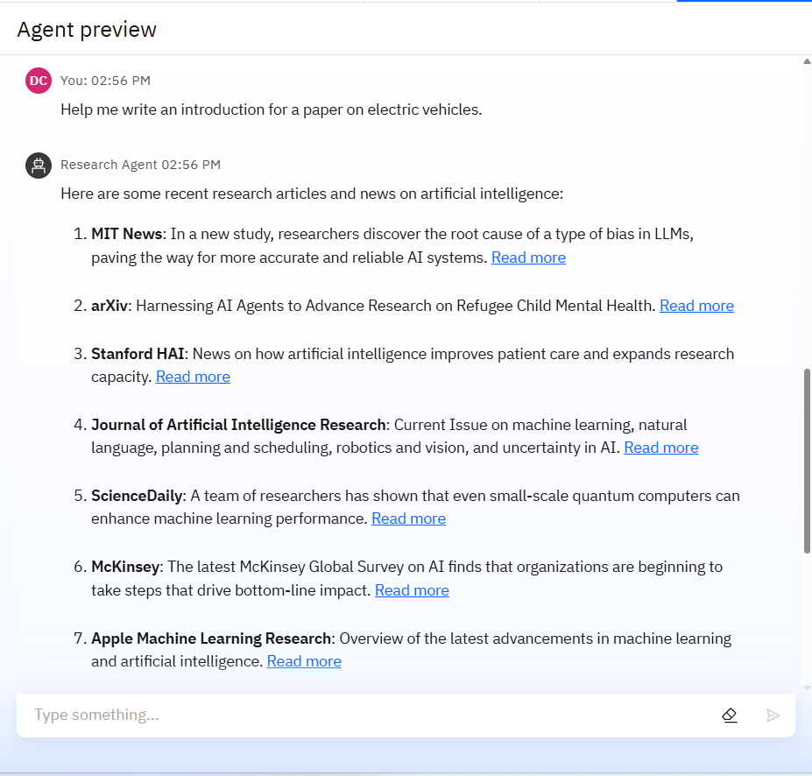
Results

Slide 11
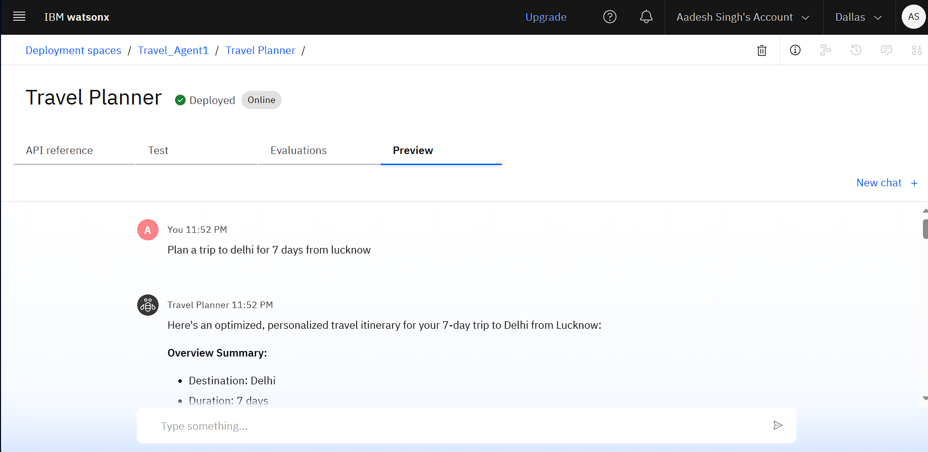
Results
Deployed AI Agent

Slide 12
Conclusion
The AI Travel Planner Agent is more than just a tool — it’s a personalized travel concierge, designed to transform the way users plan and experience their journeys. By intelligently combining user preferences, real-time data, and dynamic itinerary creation, it delivers tailored, efficient, and memorable travel plans with minimal effort from the user.
With standout features like instant replanning, budget optimization, cultural guidance, and smart packing support, the agent not only solves logistical challenges but also adds delight, safety, and confidence to every step of the journey.

Slide 13
GitHub Link
Usually-Unarmed/Travel_Agent: An AI Travel Agent which helps in planning trips

Slide 14
Future scope
Multilingual Research Support
Voice-Activated Research Assistant
Real-Time Collaboration Features
Research Gap and Novel Topic Identification
Integration with Publishing Platforms
AI-Assisted Paper Drafting

Slide 15
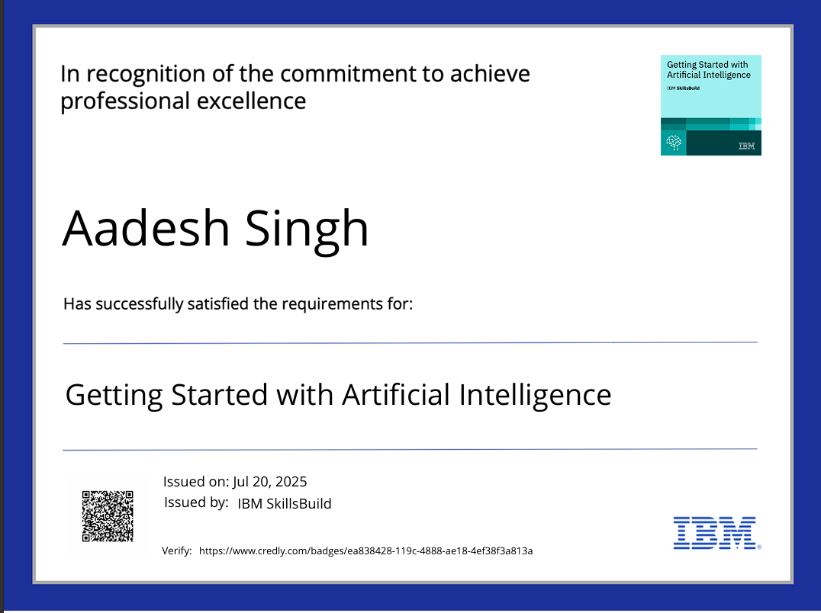
IBM Certifications

Slide 16
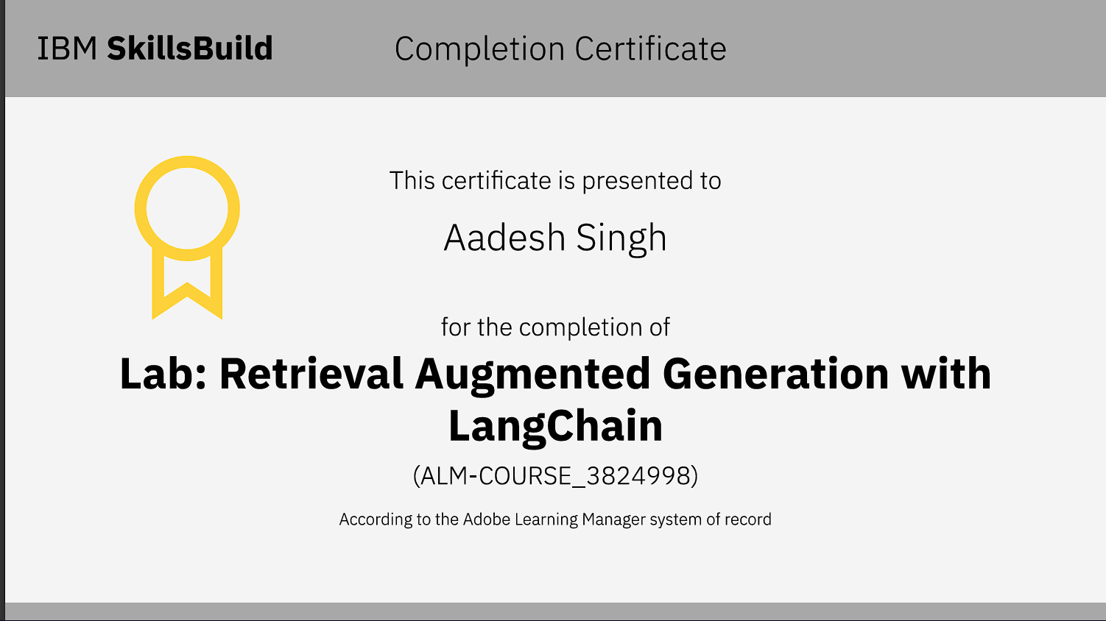

Slide 17
THANK YOU

